Slide 1
INFERTILITY IN TANZANIA
MATILDA MICHAEL NGARINA (MD, Mmed, PhD)
HEAD ART UNIT MNH
PRESIDENT AGOTA

Slide 2
DEFINITION
Is the inability of a couple to conceive after 12 months of regular unprotected sexual intercourse in a women below 35 years; and after six months of regular unprotected sexual intercourse in a women above 35 years can either be primary or secondary infertility*

Slide 3
MAGNITUDE OF THE PROBLEM
Infertility affects approximately 10-15% of the reproductive age couple/48.5m couples worldwide
19.2 million have primary infertility
Almost 29.3% of women with a previous live birth were unable to have an additional live birth (secondary infertility)
In sub-Saharan countries, the national average for prevalence ranged from 12.5% to 16%.
Prevalence in Tanzania is estimated 11%-17%

Slide 4
Why is infertility an issue
Involuntary childlessness is one of the most common, painful and socially isolating illnesses suffered by young people.
Having children is one of the most important forces for family and social cohesion throughout all societies.
Childlessness has been a burden to couples, and perhaps particularly for women, throughout history.
Infertility has significant negative social impacts on the lives of infertile couples and particularly women, who frequently experience violence, divorce, social stigma, emotional stress, depression, anxiety and low self-esteem.

Slide 5
Solution for infertility
With advances in technology there are now interventions that enable in-vitro handling of both human oocyte and sperm or of the embryo for the purpose of reproduction.
It includes but is not limited to
Artificial insemination (IUI).
Invitro fertilization (IVF) and embryo transfer.
Intracytoplasmic sperm injection (ICSI)
Preimplantation genetic testing (PIGT)
Gamet intrafallopian transfer (GIFT)
Zygot intrafallopian transfer (ZIFT)

Slide 6
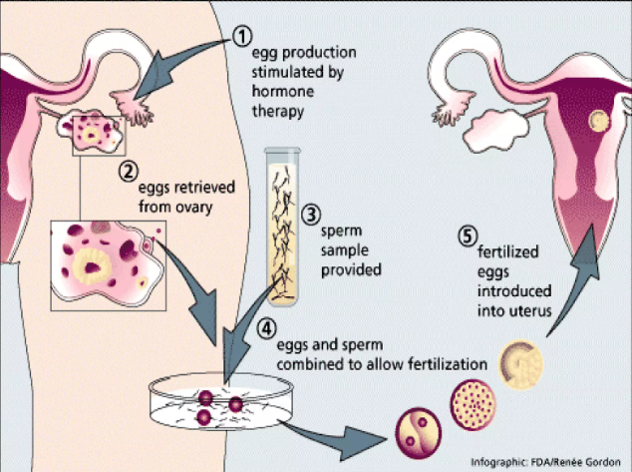
Assisted reproduction

Slide 7
What is happening in the country so far
ART clinics are coming up – 6 now, 3 in Dar
Community is becoming more aware of availability of the services in the country
The service will soon be made available in public hospitals (MNH and KCMC)
MOH is supporting both private and public hospitals and now putting regulations for efficient provision of ART services

Slide 8
WHAT IS HAPPENING AT MNH
ART unit has already been established
The ART lab is almost complete
Training of staff is on going
Purchase of IVF equipment on going
Procurement of consumables yet to follow

Slide 9
WHAT ARE OUR WISHES
Quality ART clinic, capture all cycles that would otherwise travel abroad
Ease the procurement of medical supplies and equipment for IVF
Spread of such services to all regions
Better prices affordable to the majority of the needy
Proper guidelines and policies governing ART
Training and Research in the country..

Slide 10
WHO statement on infertility and ART……
Government policies could mitigate the many inequities in access to safe and effective fertility care. To effectively address infertility, health policies need to recognize that infertility is a disease that can often be prevented, thereby mitigating the need for costly and poorly accessible treatments.

Slide 11
WHO statement cont…..
Incorporating fertility awareness in national comprehensive sexuality education programmes, promoting healthy lifestyles to reduce behavioral risks, including prevention, diagnosis and early treatment of STIs, preventing complications of unsafe abortion, postpartum sepsis and abdominal/pelvic surgery, and addressing environmental toxins associated with infertility, are policy and programmatic interventions that all governments can implement.

Slide 12
WHO statement cont….
In addition, enabling laws and policies that regulate third party reproduction and ART are essential to ensure universal access without discrimination and to protect and promote the human rights of all parties involved.
Once fertility policies are in place, it is essential to ensure that their implementation is monitored, and the quality of services is continually improved.

Slide 13
